Slide 1
First, create a background
In the bottom right corner of the screen, select the background button, and the paint option

Slide 2
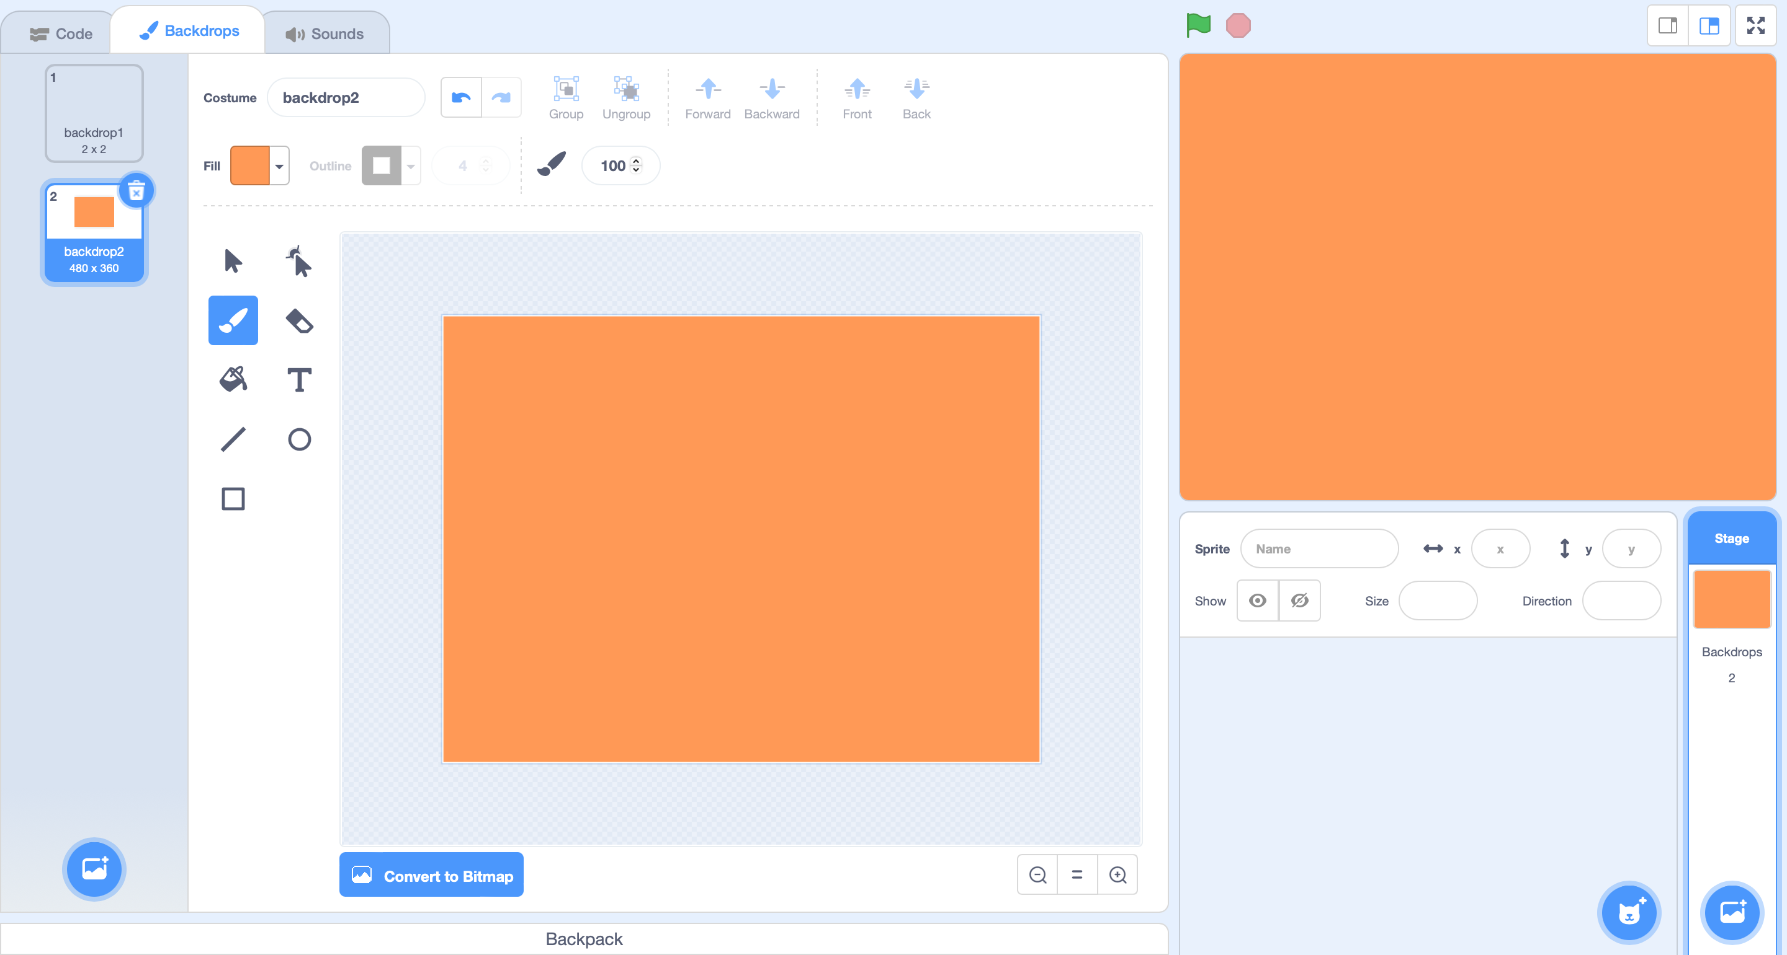
Fill the background with one color, whatever you want the wall color to be

Slide 3
Select the straight line tool
Set the color to white
Set the size to 50
Draw your maze – try to use the straightest lines possible.

Slide 4
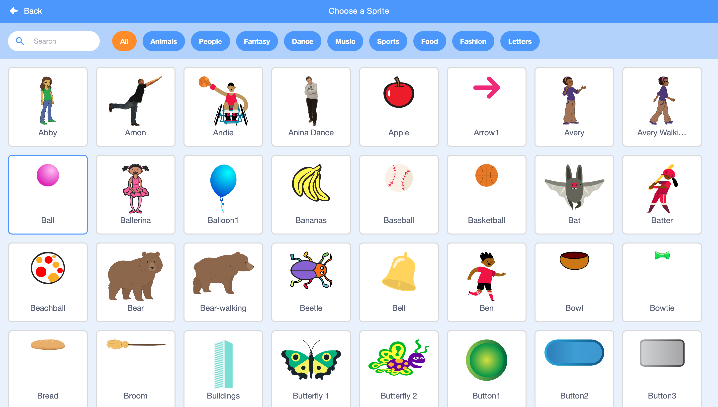
Now lets add the player
In the bottom right corner select the sprite button
Select the ball to add the sprite

Slide 5
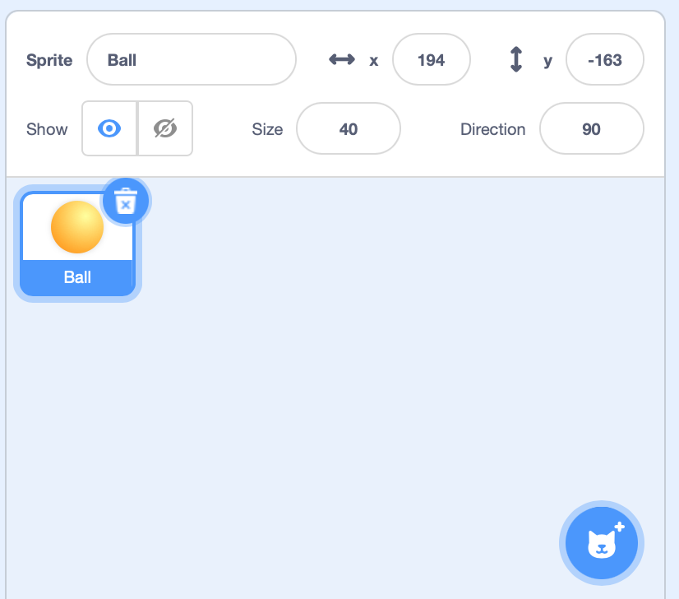
This is way to big for our maze, so set the size of the ball to 40.

Slide 6
Let’s start on the code.
In the coding interface, add the when flag clicked button – this is an event!
Now in the motion tab, add the go to position. On the screen in the top right, move the ball to the start of the maze. Insert the coordinates now shown into the go to position coordinates. This will now reset the ball whenever you restart the game

Slide 7
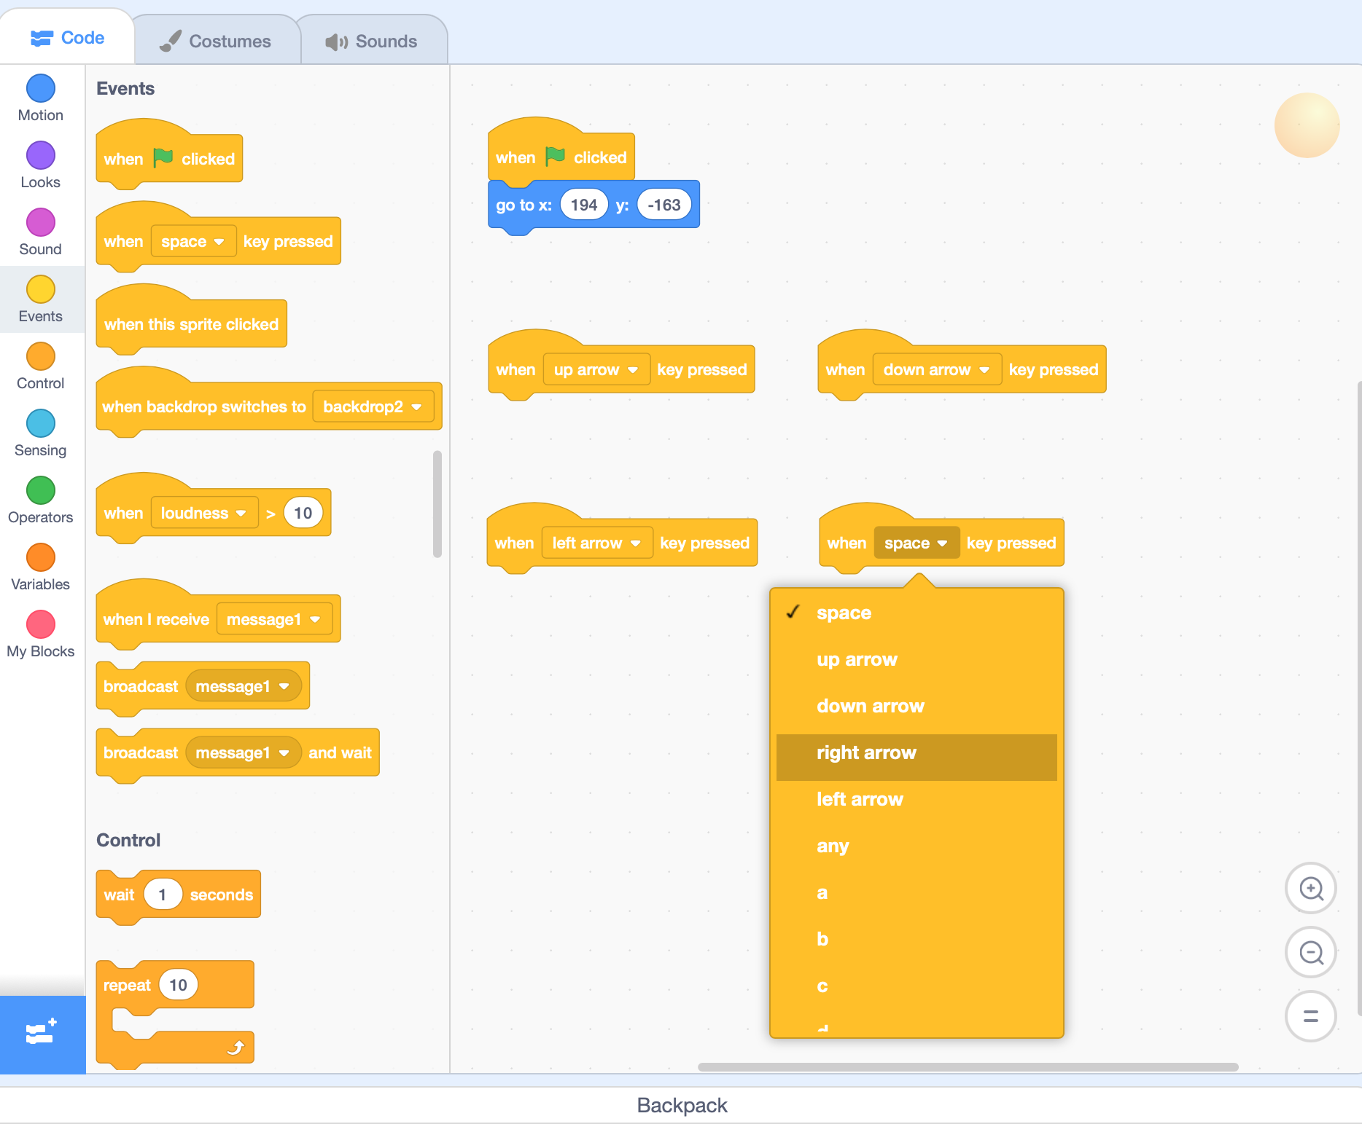
Now to add motion -
Add four when key pressed events and select one of each: up arrow, down arrow, left arrow, and right arrow

Slide 8
Now to add some real motion.
Add a change x by motion block to the left and right arrow keys, and change the values to -5 and 5.
Add a change y by motion block to the up and down arrow keys and change the values to 5 and -5

Slide 9
Now let’s add a punishment for hitting the walls – starting over!
Add the “If” block with the “Touching color” from sensing (use the eyedropper to get the exact color of your walls)
But this will only work for when you are clicking the start button. Add a forever loop around it to fix this.

